Slide 1
Micro services Design Pattern

Slide 2
Microservices
An architectural style that structures an application as a collection of small autonomous services, modeled around a business domain.
In a Microservice Architecture, each service is self-contained and implements a single business capability.

Slide 3
Principles Used to Design Microservice Architecture
The principles used to design Microservices are as follows:
Independent & Autonomous Services
Scalability
Decentralization
Resilient Services
Real-Time Load Balancing
Availability
Continuous delivery through DevOps Integration
Seamless API Integration and Continuous Monitoring
Isolation from Failures
Auto -Provisioning

Slide 4
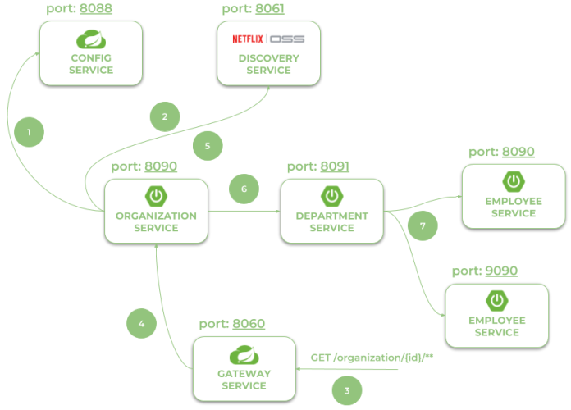
MicroServices with Spring Cloud Example
Architecture of microservices-based system
Notes:
Using Spring Boot 3 in cloud-native development
Provide service discovery for all microservices with Spring Cloud Netflix Eureka. Anticipating your questions – yes, Eureka is still there. It’s the last of Netflix microservices components still available in Spring Cloud
Spring Cloud OpenFeign in inter-service communication
Distributed configuration with Spring Cloud Config
API Gateway pattern with Spring Cloud Gateway including a global OpenAPI documentation with the Springdoc project
Collecting traces with Micrometer OpenTelemetry and Zipkin
http://localhost:8060/employee/
http://localhost:8060/department/organization/1
http://localhost:8060/department/organization/1/with-employees
http://localhost:8060/organization/
http://localhost:8060/organization/1/with-departments
http://localhost:8060/swagger-ui.html

Slide 5
MicroServices with Spring Cloud Example
Architecture of microservices-based system consists of the following modules:
gateway-service - a module that Spring Cloud Netflix Zuul for running Spring Boot application that acts as a proxy/gateway in our architecture.
config-service - a module that uses Spring Cloud Config Server for running configuration server in the native mode. The configuration files are placed on the classpath.
discovery-service - a module that depending on the example it uses Spring Cloud Netflix Eureka or Spring Cloud Netflix Alibaba Nacos as an embedded discovery server.
employee-service - a module containing the first of our sample microservices that allows to perform CRUD operation on in-memory repository of employees
department-service - a module containing the second of our sample microservices that allows to perform CRUD operation on in-memory repository of departments. It communicates with employee-service.
organization-service - a module containing the third of our sample microservices that allows to perform CRUD operation on in-memory repository of organizations. It communicates with both employee-service and organization-service.
Notes:
http://localhost:8060/employee/
http://localhost:8060/department/organization/1
http://localhost:8060/department/organization/1/with-employees
http://localhost:8060/organization/
http://localhost:8060/organization/1/with-departments
http://localhost:8060/swagger-ui.html

Slide 6
Hands On
Step 1 – Create Project
Go to Spring Initializr
Dependencies:
Spring Web
Spring Data JPA
PostgreSQL
Lombok
Step 2 – Create Entity
  @Entity
  public class Customer {
  @Id
  private Long id;
  private String name;
  private String email;
  }
Explain:
@Entity → maps to database table

Slide 7
Hands On
Step 3 – Repository
  public interface CustomerRepository extends JpaRepository<Customer, Long> {
  }
Step 4 – Service
  @Service
  public class CustomerService {
  @Autowired
  CustomerRepository repository;
  public List<Customer> getAllCustomers() {
  return repository.findAll();
  }
  }

Slide 8
Hands On
Step 5 – Controller
@RestController
@RequestMapping("/customers")
public class CustomerController {
@Autowired
CustomerService service;
@GetMapping
public List<Customer> getAll() {
return service.getAllCustomers();
}
}
Run application.
Test in browser:
http://localhost:8081/customers

Slide 9
Design Patterns of Microservices
Decomposition Patterns
Integrator Patterns
Database Patterns
Observability Patterns
Cross-Cutting Concern Patterns

Slide 10
Decomposition Patterns
Decompose by Business Capability
Problem
Microservices is all about making services loosely coupled, applying the single responsibility principle. However, breaking an application into smaller pieces has to be done logically. How do we decompose an application into small services?
Solution
One strategy is to decompose by business capability. A business capability is something that a business does in order to generate value. The set of capabilities for a given business depend on the type of business. For example, the capabilities of an insurance company typically include sales, marketing, underwriting, claims processing, billing, compliance, etc. Each business capability can be thought of as a service, except it’s business-oriented rather than technical.

Slide 11
Decomposition Patterns
Decompose by Subdomain
Problem
Decomposing an application using business capabilities might be a good start, but you will come across so-called "God Classes" which will not be easy to decompose. These classes will be common among multiple services. For example, the Order class will be used in Order Management, Order Taking, Order Delivery, etc. How do we decompose them?
Solution
For the "God Classes" issue, DDD (Domain-Driven Design) comes to the rescue. It uses subdomains and bounded context concepts to solve this problem. DDD breaks the whole domain model created for the enterprise into subdomains. Each subdomain will have a model, and the scope of that model will be called the bounded context. Each microservice will be developed around the bounded context.
Note: Identifying subdomains is not an easy task. It requires an understanding of the business. Like business capabilities, subdomains are identified by analyzing the business and its organizational structure and identifying the different areas of expertise.

Slide 12
Strangler Pattern
Problem
So far, the design patterns we talked about were decomposing applications for greenfield, but 80% of the work we do is with brownfield applications, which are big, monolithic applications. Applying all the above design patterns to them will be difficult because breaking them into smaller pieces at the same time it's being used live is a big task.
Solution
The Strangler pattern comes to the rescue. The Strangler pattern is based on an analogy to a vine that strangles a tree that it’s wrapped around. This solution works well with web applications, where a call goes back and forth, and for each URI call, a service can be broken into different domains and hosted as separate services. The idea is to do it one domain at a time. This creates two separate applications that live side by side in the same URI space. Eventually, the newly refactored application “strangles” or replaces the original application until finally you can shut off the monolithic application.

Slide 13
Integrator Pattern
API Gateway Pattern
Aggregator Pattern
Client-Side UI Composition Pattern

Slide 14
API Gateway Pattern
Problem
When an application is broken down to smaller microservices, there are a few concerns that need to be addressed:
How to call multiple microservices abstracting producer information.
On different channels (like desktop, mobile, and tablets), apps need different data to respond for the same backend service, as the UI might be different.
Different consumers might need a different format of the responses from reusable microservices. Who will do the data transformation or field manipulation?
How to handle different type of Protocols some of which might not be supported by producer microservice.
Solution
An API Gateway helps to address many concerns raised by microservice implementation, not limited to the ones above.
An API Gateway is the single point of entry for any microservice call.
It can work as a proxy service to route a request to the concerned microservice, abstracting the producer details.
It can fan out a request to multiple services and aggregate the results to send back to the consumer.
One-size-fits-all APIs cannot solve all the consumer's requirements; this solution can create a fine-grained API for each specific type of client.
It can also convert the protocol request (e.g. AMQP) to another protocol (e.g. HTTP) and vice versa so that the producer and consumer can handle it.
It can also offload the authentication/authorization responsibility of the microservice.

Slide 15
Aggregator Pattern
Problem
We have talked about resolving the aggregating data problem in the API Gateway Pattern. However, we will talk about it here holistically. When breaking the business functionality into several smaller logical pieces of code, it becomes necessary to think about how to collaborate the data returned by each service. This responsibility cannot be left with the consumer, as then it might need to understand the internal implementation of the producer application.
Solution
The Aggregator pattern helps to address this. It talks about how we can aggregate the data from different services and then send the final response to the consumer. This can be done in two ways:
1. A composite microservice will make calls to all the required microservices, consolidate the data, and transform the data before sending back.
2. An API Gateway can also partition the request to multiple microservices and aggregate the data before sending it to the consumer.
It is recommended if any business logic is to be applied, then choose a composite microservice. Otherwise, the API Gateway is the established solution.

Slide 16
Aggregator Pattern
The Aggregator design pattern in Microservice architecture is a design pattern used to compose a complex service by aggregating the responses of multiple independent microservices.
It's also one of the essential Microservices Design patterns along with SAGA, CQRS, and Event Sourcing.
This pattern is proper when a client request requires data or functionality distributed across multiple microservices.
It can improve the performance and scalability of the system by allowing each microservice to focus on a specific task and reducing the workload of a single microservice.
We are going to discuss how the Aggregator Microservice Pattern can be implemented in Java using various approaches, such as asynchronous communication, synchronous communication, or a combination of both.

Slide 17
Aggregator Pattern Example
In Java, the Aggregator Microservice Pattern can be implemented using various approaches, such as
  Asynchronous communication
  Synchronous communication
  Combination of both

Slide 18
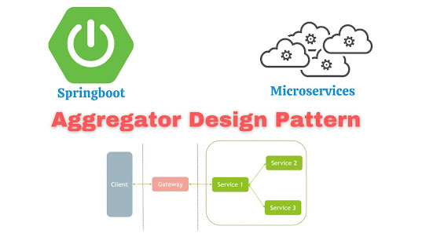
Aggregator Pattern Example-Asynchronous communication
  One way to implement the Aggregator Microservice Pattern in Java is by using asynchronous communication between the microservices. In this approach, the client sends a request to the aggregator microservice, which then sends requests to the individual microservices in parallel.
  Each microservice processes the request and sends the response back to the aggregator microservice, which then aggregates the responses and returns the result to the client.
  This approach has the advantage of improving the performance of the system by allowing the microservices to process the requests concurrently. However, it requires the use of an asynchronous communication mechanism, such as message queues or event-driven architectures, which can introduce additional complexity to the system.

Slide 19
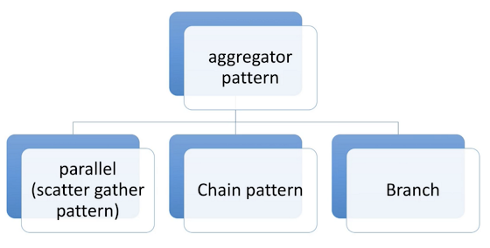
Aggregator Pattern Example-Asynchronous communication
  In this example, the AsyncAggregatorMicroservice class uses the CompletableFuture class from the Java Concurrency API to send requests to the individual microservices asynchronously.
  The CompletableFuture.allOf() method is used to wait for all the responses to be received, and the thenApply() method is used to aggregate the responses and return the result to the client.
public class AsyncAggregatorMicroservice {
private final ExecutorService executorService;
private final Microservice1Client microservice1Client;
private final Microservice2Client microservice2Client;
private final Microservice3Client microservice3Client;
public AsyncAggregatorMicroservice(ExecutorService executorService, Microservice1Client microservice1Client, Microservice2Client microservice2Client, Microservice3Client microservice3Client) {
this.executorService = executorService;
this.microservice1Client = microservice1Client;
this.microservice2Client = microservice2Client;
this.microservice3Client = microservice3Client;
}
public CompletableFuture<AggregatedResponse> processRequest(Request request) {
CompletableFuture<Response1> response1Future
= CompletableFuture.supplyAsync(()
-> microservice1Client.processRequest(request), executorService);
CompletableFuture<Response2> response2Future
= CompletableFuture.supplyAsync(()
-> microservice2Client.processRequest(request), executorService);
CompletableFuture<Response3> response3Future
= CompletableFuture.supplyAsync(()
-> microservice3Client.processRequest(request), executorService);
return CompletableFuture.allOf(response1Future, response2Future, response3Future)
.thenApply(v ->
new AggregatedResponse(response1Future.join(), response2Future.join(),
response3Future.join()));
}
}

Slide 20
Aggregator Pattern Example-Synchronous Communication
Another way to implement the Aggregator Microservice Pattern in Java is by using synchronous communication between the microservices.
In this approach, the client sends a request to the aggregator microservice, which then sends requests to the individual microservices sequentially.
Each microservice processes the request and sends the response back to the aggregator microservice, which then aggregates the responses and returns the result to the client.
This approach has the advantage of simplicity, as it does not require the use of asynchronous communication mechanisms.
However, it can have a negative impact on the performance of the system, as the aggregator microservice has to wait for each microservice to complete its task before moving on to the next one.

Slide 21
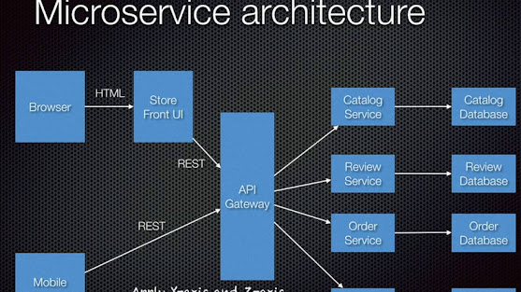
Aggregator Pattern Example-Synchronous communication
  In this example, the SyncAggregatorMicroservice class sends requests to the individual microservices synchronously, one after the other.
  The responses are then aggregated and returned to the client.
public class SyncAggregatorMicroservice {
private final Microservice1Client microservice1Client;
private final Microservice2Client microservice2Client;
private final Microservice3Client microservice3Client;
public SyncAggregatorMicroservice(Microservice1Client microservice1Client, Microservice2Client microservice2Client,
Microservice3Client microservice3Client) {
this.microservice1Client = microservice1Client;
this.microservice2Client = microservice2Client;
this.microservice3Client = microservice3Client;
}
public AggregatedResponse processRequest(Request request) {
Response1 response1 = microservice1Client.processRequest(request);
Response2 response2 = microservice2Client.processRequest(request);
Response3 response3 = microservice3Client.processRequest(request);
return new AggregatedResponse(response1, response2, response3);
}
}

Slide 22
Aggregator Pattern Example- Combination of Asynchronous and Synchronous Communication
It is also possible to implement the Aggregator Microservice Pattern in Java by combining asynchronous and synchronous communication.
In this approach, the client sends a request to the aggregator microservice, which then sends requests to some of the microservices asynchronously and to others synchronously, depending on the requirements of the system.
This approach allows for a balance between performance and simplicity, as it allows the microservices to process the requests concurrently where possible, while still keeping the implementation straightforward.

Slide 23
Aggregator Pattern Example- Combination of Asynchronous and Synchronous Communication
An example of an Aggregator Microservice that uses a combination of asynchronous and synchronous communication in Java:
import java.util.concurrent.CompletableFuture;
import java.util.concurrent.ExecutorService;
public class HybridAggregatorMicroservice {
private final ExecutorService executorService;
private final Microservice1Client microservice1Client;
private final Microservice2Client microservice2Client;
private final Microservice3Client microservice3Client;
public HybridAggregatorMicroservice(ExecutorService executorService, Microservice1Client microservice1Client,
Microservice2Client microservice2Client, Microservice3Client microservice3Client) {
this.executorService = executorService;
this.microservice1Client = microservice1Client;
this.microservice2Client = microservice2Client;
this.microservice3Client = microservice3Client;
}
public AggregatedResponse processRequest(Request request) {
CompletableFuture<Response1> response1Future = CompletableFuture
.supplyAsync(() -> microservice1Client.processRequest(request), executorService);
Response2 response2 = microservice2Client.processRequest(request);
CompletableFuture<Response3> response3Future = CompletableFuture
.supplyAsync(() -> microservice3Client.processRequest(request), executorService);
return CompletableFuture.allOf(response1Future, response3Future)
.thenApply(v -> new AggregatedResponse(response1Future.join(), response2, response3Future.join()));
}
}
Notes:
In this example, the `HybridAggregatorMicroservice` class sends requests to the `microservice1Client` and `microservice3Client` asynchronously, and to the `microservice2Client` synchronously. The responses are then aggregated and returned to the client.
The Aggregator Microservice Pattern in Java is a useful design pattern for composing complex services by aggregating the responses of multiple independent microservices. In Java, this pattern can be implemented using asynchronous communication, synchronous communication, or a combination of both, depending on the requirements of the system.
Asynchronous communication can improve the performance of the system, but it requires the use of additional communication mechanisms. Synchronous communication is simpler to implement, but it can have a negative impact on performance.
A combination of asynchronous and synchronous communication allows for a balance between performance and simplicity.
Read more: https://www.java67.com/2023/01/aggregator-microservice-pattern-in-java.html#ixzz8KQqKEgep
Read more: https://www.java67.com/2023/01/aggregator-microservice-pattern-in-java.html#ixzz8KQqEnaDk

Slide 24
Client-Side UI Composition Pattern
Problem
When services are developed by decomposing business capabilities/subdomains, the services responsible for user experience have to pull data from several microservices. In the monolithic world, there used to be only one call from the UI to a backend service to retrieve all data and refresh/submit the UI page. However, now it won't be the same. We need to understand how to do it.
Solution
With microservices, the UI has to be designed as a skeleton with multiple sections/regions of the screen/page. Each section will make a call to an individual backend microservice to pull the data. That is called composing UI components specific to service. Frameworks like AngularJS and ReactJS help to do that easily. These screens are known as Single Page Applications (SPA). This enables the app to refresh a particular region of the screen instead of the whole page.

Slide 25
Database Pattern
Database per Service
Shared Database per Service
Command Query Responsibility Segregation (CQRS)
Saga Pattern

Slide 26
Database per Service
Problem
There is a problem of how to define database architecture for microservices. Following are the concerns to be addressed:
1. Services must be loosely coupled. They can be developed, deployed, and scaled independently.
2. Business transactions may enforce invariants that span multiple services.
3. Some business transactions need to query data that is owned by multiple services.
4. Databases must sometimes be replicated and sharded in order to scale.
5. Different services have different data storage requirements.
Solution
To solve the above concerns, one database per microservice must be designed; it must be private to that service only. It should be accessed by the microservice API only. It cannot be accessed by other services directly. For example, for relational databases, we can use private-tables-per-service, schema-per-service, or database-server-per-service. Each microservice should have a separate database id so that separate access can be given to put up a barrier and prevent it from using other service tables.

Slide 27
Shared Database per Service
Problem
We have talked about one database per service being ideal for microservices, but that is possible when the application is greenfield and to be developed with DDD. But if the application is a monolith and trying to break into microservices, denormalization is not that easy. What is the suitable architecture in that case?
Solution
A shared database per service is not ideal, but that is the working solution for the above scenario. Most people consider this an anti-pattern for microservices, but for brownfield applications, this is a good start to break the application into smaller logical pieces. This should not be applied for greenfield applications. In this pattern, one database can be aligned with more than one microservice, but it has to be restricted to 2-3 maximum, otherwise scaling, autonomy, and independence will be challenging to execute.

Slide 28
Command Query Responsibility Segregation (CQRS)
Problem
Once we implement database-per-service, there is a requirement to query, which requires joint data from multiple services — it's not possible. Then, how do we implement queries in microservice architecture?
Solution
CQRS suggests splitting the application into two parts — the command side and the query side. The command side handles the Create, Update, and Delete requests. The query side handles the query part by using the materialized views. The event sourcing pattern is generally used along with it to create events for any data change. Materialized views are kept updated by subscribing to the stream of events.

Slide 29
Saga Pattern
Problem
When each service has its own database and a business transaction spans multiple services, how do we ensure data consistency across services? For example, for an e-commerce application where customers have a credit limit, the application must ensure that a new order will not exceed the customer’s credit limit. Since Orders and Customers are in different databases, the application cannot simply use a local ACID transaction.
Solution
A Saga represents a high-level business process that consists of several sub requests, which each update data within a single service. Each request has a compensating request that is executed when the request fails. It can be implemented in two ways:
Choreography — When there is no central coordination, each service produces and listens to another service’s events and decides if an action should be taken or not.
Orchestration — An orchestrator (object) takes responsibility for a saga’s decision making and sequencing business logic.

Slide 30
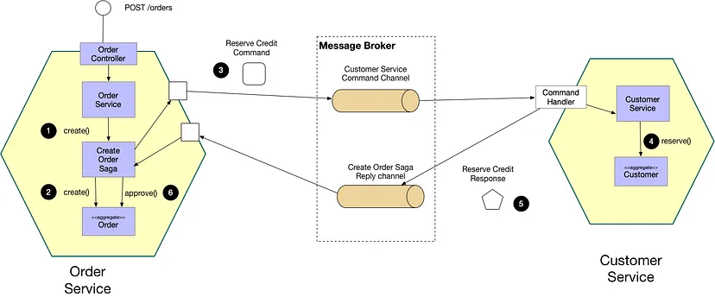
Saga Pattern
Notes:
A microservice is a distributed system made up of numerous smaller services that work together to offer overall application functionality. [1]
Although this architectural style has many advantages, it also has some drawbacks. One of the biggest issues is determining how to manage a transaction that involves numerous services. [1]
While the transaction spans numerous services in a distributed transaction scenario, maintaining ACID (atomicity, consistency, isolation, and durability) is always critical. The second difficulty is controlling the transaction isolation level. It determines the quantity of data visible in a transaction when other services access the same data at the same time.

Slide 31
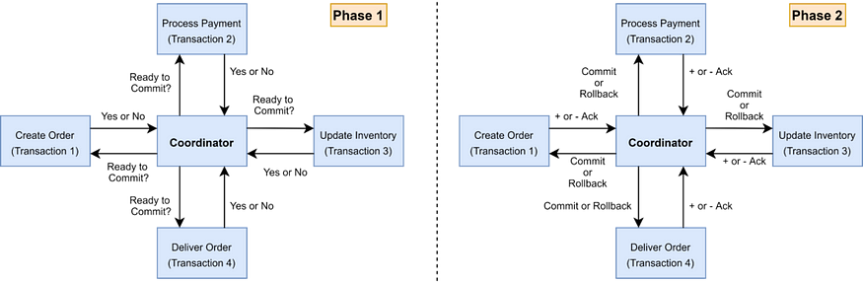
Saga Pattern – 2PC
Two Phase Commiting Protocol (2PC)
  2PC is a popular method for implementing distributed transactions.
  There is a coordinator component that is in charge of controlling the transaction and containing the transaction logic.
  The participating nodes, which perform their local transactions, are the other component.
Notes:
There are two phases. In phase one, the coordinator asks the participating nodes if they are ready to commit the transaction and waits for a yes or no response. If all nodes replied yes in phase 1, the coordinator instructs all nodes to commit; otherwise, the coordinator instructs all nodes to roll back.

Slide 32
Saga Pattern – 2PC
The downsides of 2pc protocols are as follows:
The coordinator is responsible for all services, which might lead to a single point of failure.
Because the controller determines when all services are completed, the entire performance of the operation is bound to the slowest service. [
NoSQL databases do not support 2pc.

Slide 33
Saga Architecture Pattern
This pattern manages transactions through a series of local transactions.
After successfully completing the previous phase, the Saga Pattern triggers the next step with the incoming request.
A Saga participant’s work is represented by a local transaction.
Every operation in the Saga can be reversed by a compensatory transaction.
A compensatory transaction must be reversible and idempotent.

Slide 34
Saga Architecture Pattern
The Saga Execution Coordinator
  The Saga Execution Coordinator is the key component in putting a Saga flow into action. It includes a Saga log, which records the sequence of events in a distributed transaction.
  In the event of a failure, the SEC component examines the Saga log to determine which components are affected and the order in which compensating transactions should be executed.
  If there is a failure in the SEC component, it can read the Saga log when it restarts. It can then determine which transactions were successfully rolled back and which are still pending, and take appropriate action.
  The Saga pattern can be implemented in two ways: choreography and orchestration.

Slide 35
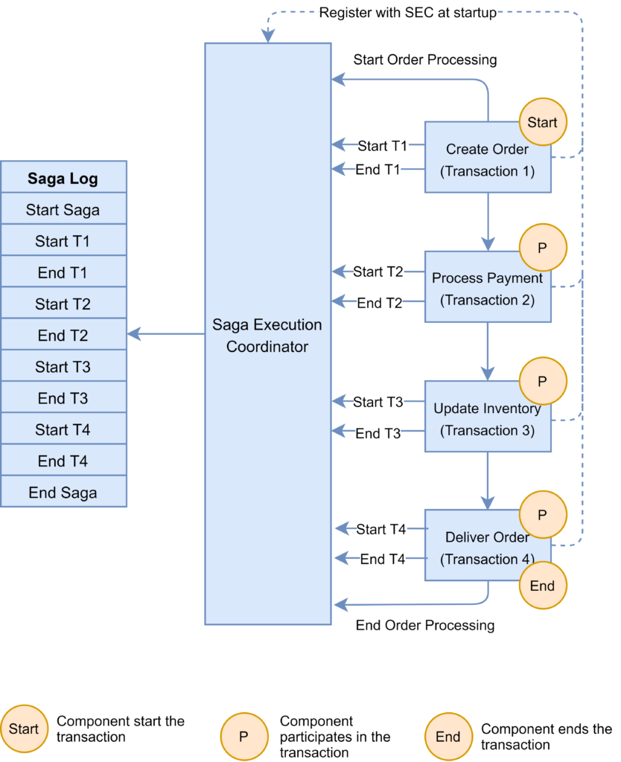
Saga Architecture Pattern
Saga Orchestration Pattern
  Microservices are controlled by an orchestrator or conductor.
  This allows centralized control of the saga or workflow.
  The orchestrator or conductor could be centralized for all the sagas or workflows or could be distributed as individual services for each saga or workflow.
  This provides varying levels of independence to each microservice.

Slide 36
Saga Architecture Pattern
Saga Orchestration Pattern’s Benefits
  Centralizes the handling of scattered transactions.
  Simple to set up and test.
  Easy rollback administration.
  As new steps are added, the process becomes less complex than the choreographic technique.
  We have the ability to manage pending transactions.
Saga Orchestration Pattern’s Drawbacks
The complexity of your infrastructure grows when you manage an additional saga orchestrator service.

Slide 37
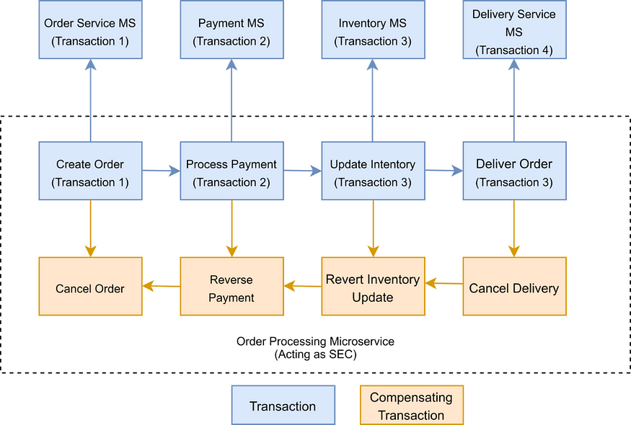
Saga Architecture Pattern
Saga Choreography Pattern
  Microservices work independently but coordinate with each other using cues or events.
  The method of control of the saga or workflow is determined by a predefined set of cues or events.

Slide 38
Saga Architecture Pattern
  Saga Choreography Pattern
  Benefits :
  Simple to understand and install into an existing system because the services that trigger the event are distinct from each other.
  It can be quite useful if your procedure has two to four steps.
  Drawbacks :
  However, keeping track of which service is listening to which events can grow more complex as the flow becomes more complex.
  As services must subscribe to one another, there may be cyclical dependencies.
  Testing is tough since all services must be operational in order to thoroughly test the system.
  Note: The Axon Saga framework can be used to implement Saga patterns.
  The Axon Saga framework is a Spring Boot-based lightweight saga pattern framework.

Slide 39
Saga Architecture Pattern
  Which Saga Pattern to use?
    System complexity
    Coordination requirements
    Fault tolerance and scalability
    Centralization vs. decentralization trade-offs
Notes:
System complexity: The orchestration pattern is appropriate for systems with complicated business logic, where the control flow must be controlled centrally to maintain consistency and compliance with business requirements. The choreography pattern, on the other hand, is better suited for systems with basic business logic, where services can work independently and interact via event-based communication. [3]
Coordination requirements: The orchestration pattern is beneficial when tight coordination and interaction between services is required, as the orchestrator may handle communication and guarantee that each service completes its duty before moving on to the next. The choreography design, on the other hand, is better suited for loosely connected systems in which each service can work independently and communicate with other services as needed. [3]
Fault tolerance and scalability: Because the central orchestrator can handle errors and retries and improve system flow, the orchestration pattern can be more fault-tolerant and scalable. Choreography patterns, on the other hand, can be more durable and flexible to changes because each service can react to events and update its behavior without relying on a central component. [3]
Centralization vs. decentralization trade-offs: The orchestration pattern centralizes control and decision-making, which simplifies system development and management but introduces a single point of failure and a possible bottleneck. The choreography pattern, on the other hand, distributes power and decision-making, which can boost service autonomy and flexibility while also making the system more complex and difficult to operate. [3]

Slide 40
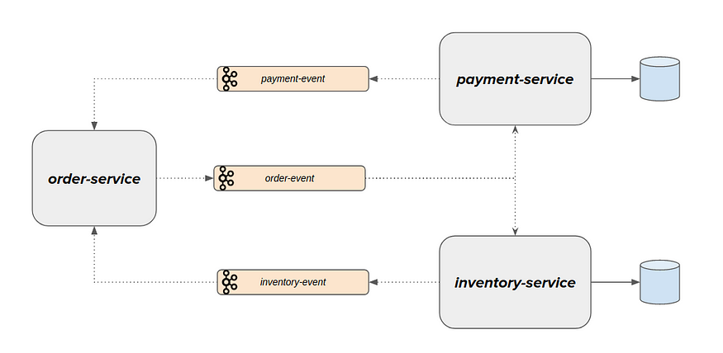
Saga Architecture Pattern
  Implementing Choreography-based Saga Pattern in Spring Boot
  Event Sourcing
    Every change in an application’s state is recorded as an event.
    This event is saved in the database/event store (for tracking purposes) and is also broadcast on the event bus for consumption by other parties.
    Example
Notes:
A command to make a new order is received by the “order-service”. This request is executed and raised as an event when an order is created. OrderCreated event (used past tense because it has already occurred) simply informs “order-service” that a new order request has been received and is being held in the PENDING/CREATED status and it has not yet been fulfilled.
The payment/inventory service may now be interested in listening to those occurrences and reserving/rejecting payment/inventory. Even these might be considered an event. Payment has been reserved/rejected for the event. Payment reserved/rejected event and Order-service may listen to these events and fulfill/cancel the initial purchase request.

Slide 41
Observability Patterns
Log Aggregation
Performance Metrics
Distributed Tracing
Health Check

Slide 42
Log Aggregation
Problem
Consider a use case where an application consists of multiple service instances that are running on multiple machines. Requests often span multiple service instances. Each service instance generates a log file in a standardized format. How can we understand the application behavior through logs for a particular request?
Solution
We need a centralized logging service that aggregates logs from each service instance. Users can search and analyze the logs. They can configure alerts that are triggered when certain messages appear in the logs. For example, PCF does have Loggeregator, which collects logs from each component (router, controller, diego, etc...) of the PCF platform along with applications. AWS Cloud Watch also does the same.

Slide 43
Performance Metrics
Problem
When the service portfolio increases due to microservice architecture, it becomes critical to keep a watch on the transactions so that patterns can be monitored and alerts sent when an issue happens. How should we collect metrics to monitor application perfomance?
Solution
A metrics service is required to gather statistics about individual operations. It should aggregate the metrics of an application service, which provides reporting and alerting. There are two models for aggregating metrics:
Push — the service pushes metrics to the metrics service e.g. NewRelic, AppDynamics
Pull — the metrics services pulls metrics from the service e.g. Prometheus

Slide 44
Distributed Tracing
Problem
In microservice architecture, requests often span multiple services. Each service handles a request by performing one or more operations across multiple services. Then, how do we trace a request end-to-end to troubleshoot the problem?
Solution
We need a service which
Assigns each external request a unique external request id.
Passes the external request id to all services.
Includes the external request id in all log messages.
Records information (e.g. start time, end time) about the requests and operations performed when handling an external request in a centralized service.
Spring Cloud Slueth, along with Zipkin server, is a common implementation.

Slide 45
Health Check
Problem
When microservice architecture has been implemented, there is a chance that a service might be up but not able to handle transactions. In that case, how do you ensure a request doesn't go to those failed instances? With a load balancing pattern implementation.
Solution
Each service needs to have an endpoint which can be used to check the health of the application, such as /health. This API should o check the status of the host, the connection to other services/infrastructure, and any specific logic.
Spring Boot Actuator does implement a /health endpoint and the implementation can be customized, as well.

Slide 46
Cross-Cutting Concern Patterns
External Configuration
Service Discovery Pattern
Circuit Breaker Pattern
Blue-Green Deployment Pattern

Slide 47
External Configuration
Problem
A service typically calls other services and databases as well. For each environment like dev, QA, UAT, prod, the endpoint URL or some configuration properties might be different. A change in any of those properties might require a re-build and re-deploy of the service. How do we avoid code modification for configuration changes?
Solution
Externalize all the configuration, including endpoint URLs and credentials. The application should load them either at startup or on the fly.
Spring Cloud config server provides the option to externalize the properties to GitHub and load them as environment properties. These can be accessed by the application on startup or can be refreshed without a server restart.

Slide 48
Service Discovery Pattern
Problem
When microservices come into the picture, we need to address a few issues in terms of calling services:
With container technology, IP addresses are dynamically allocated to the service instances. Every time the address changes, a consumer service can break and need manual changes.
Each service URL has to be remembered by the consumer and become tightly coupled.
So how does the consumer or router know all the available service instances and locations?
Solution
A service registry needs to be created which will keep the metadata of each producer service. A service instance should register to the registry when starting and should de-register when shutting down. The consumer or router should query the registry and find out the location of the service. The registry also needs to do a health check of the producer service to ensure that only working instances of the services are available to be consumed through it. There are two types of service discovery: client-side and server-side. An example of client-side discovery is Netflix Eureka and an example of server-side discovery is AWS ALB.

Slide 49
Circuit Breaker Pattern
Problem
A service generally calls other services to retrieve data, and there is the chance that the downstream service may be down. There are two problems with this: first, the request will keep going to the down service, exhausting network resources and slowing performance. Second, the user experience will be bad and unpredictable. How do we avoid cascading service failures and handle failures gracefully?
Solution
The consumer should invoke a remote service via a proxy that behaves in a similar fashion to an electrical circuit breaker. When the number of consecutive failures crosses a threshold, the circuit breaker trips, and for the duration of a timeout period, all attempts to invoke the remote service will fail immediately. After the timeout expires the circuit breaker allows a limited number of test requests to pass through. If those requests succeed, the circuit breaker resumes normal operation. Otherwise, if there is a failure, the timeout period begins again.
Netflix Hystrix is a good implementation of the circuit breaker pattern. It also helps you to define a fallback mechanism which can be used when the circuit breaker trips. That provides a better user experience.

Slide 50
Blue-Green Deployment Pattern
Problem
With microservice architecture, one application can have many microservices. If we stop all the services then deploy an enhanced version, the downtime will be huge and can impact the business. Also, the rollback will be a nightmare. How do we avoid or reduce downtime of the services during deployment?
Solution
The blue-green deployment strategy can be implemented to reduce or remove downtime. It achieves this by running two identical production environments, Blue and Green. Let's assume Green is the existing live instance and Blue is the new version of the application. At any time, only one of the environments is live, with the live environment serving all production traffic. All cloud platforms provide options for implementing a blue-green deployment.
There are many other patterns used with microservice architecture, like Sidecar, Chained Microservice, Branch Microservice, Event Sourcing Pattern, Continuous Delivery Patterns, and more. The list keeps growing as we get more experience with microservices. I am stopping now to hear back from you on what microservice patterns you are using.

